Slide 1

Healthcare Analytics – EMR BI Dashboard
Excelr Data analyst project
Project: DA_P909 (Healthcare)

Slide 2

1. Group Details:
Group Members:
Members Name | Roles in this Project
1. Syed Yaseen | Power Bi Analyst & SQL
2. Hrishikesh Manohar Dhondge | Tableau Analyst
3. Akash Roshan R | Data Engineer (MYSQL)
4. Kovori Venkata Sarika | Excel Analyst
5. Tejaswini Shreyas Kurumbhatte | Excel Analyst
6. Manjunath M A. | Power Bi Analyst
7. Manasi Shashikant Chavan | Data Engineer (MYSQL)
Project Mentor : Mahendra Singh

Slide 3

2. Project Summary:
Objective
Develop an intuitive, data-driven BI dashboard for Electronic Medical Records (EMR) to: 1. Enhance operational efficiency – Optimize doctor workload, resource allocation, and patient scheduling. 2. Improve clinical outcomes – Track treatment success rates, follow-ups, and abnormal lab results. 3. Drive revenue growth – Identify high-value services (e.g., CT scans, chronic care) and cost-saving opportunities.
Scope
Data Sources: EMR systems, lab results, billing records, patient demographics.
KPIs Tracked: 12+ metrics (e.g., revenue, patient volume, treatment costs, follow-up rates).
Tools: Power BI, Tableau, Excel, SQL (data transformation).

Slide 4








3. KPI List:
1. Total Patients
2. Total Doctors
3. Total Visits
4. Average
Age of Patients
5. Top 5 Diagnosed Conditions
6. Follow-Up Rate
7. Treatment Cost
Per Visit (Avg.)
8. Total Lab Tests Conducted
9. Percentage of Abnormal Lab Results
10. Doctor Workload (Avg Patients Per Doctor)
11. Total
Revenue

Slide 5
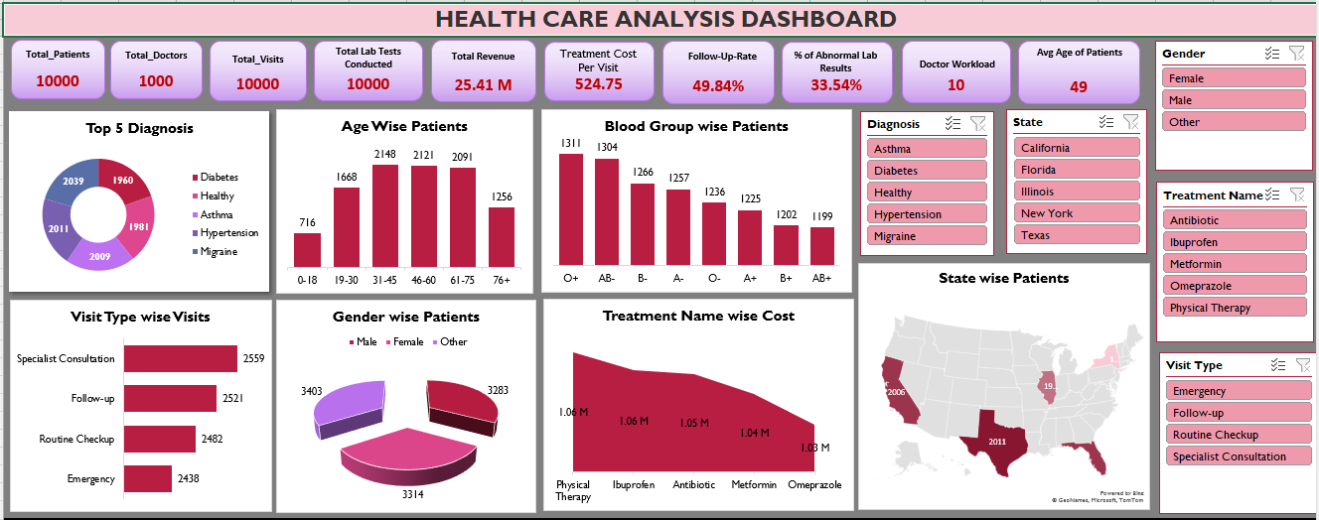
4. Excel Dashboard:

Slide 6
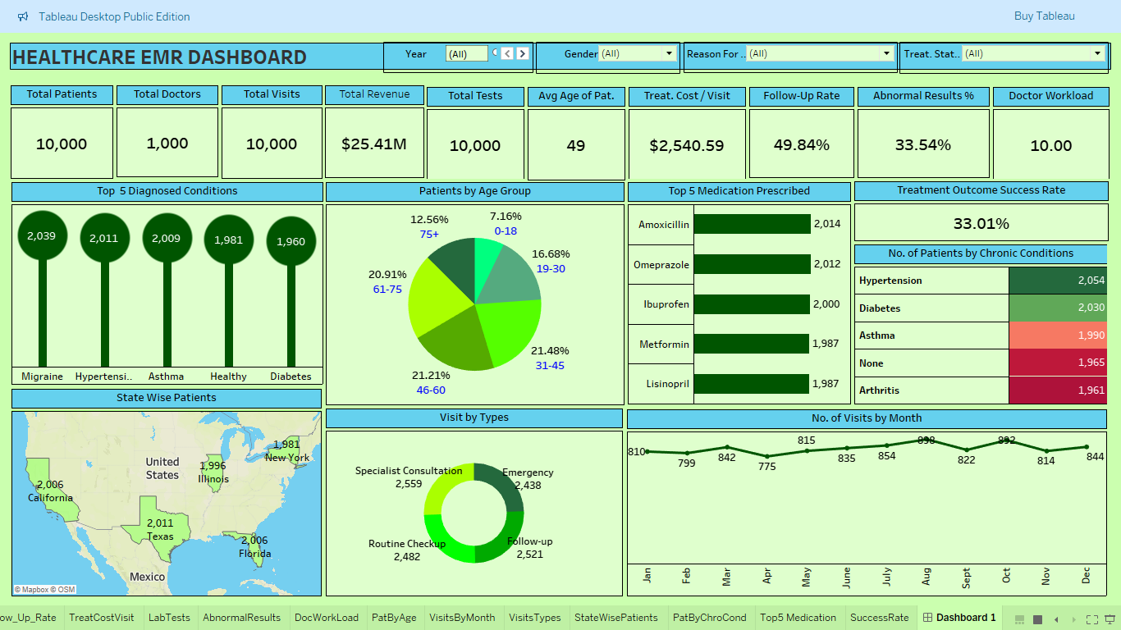
5. Tableau Dashboard:

Slide 7
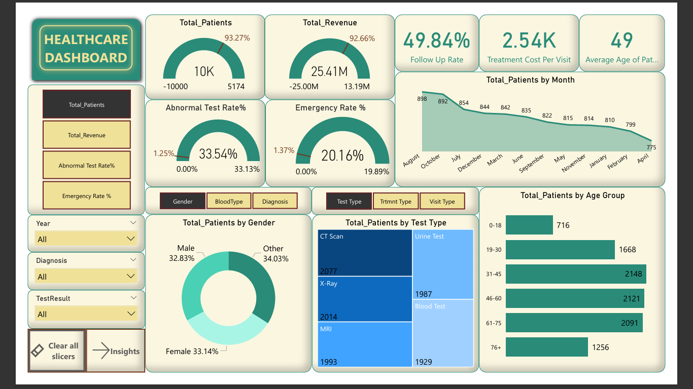
6. Power Bi Dashboard Page 1:

Slide 8
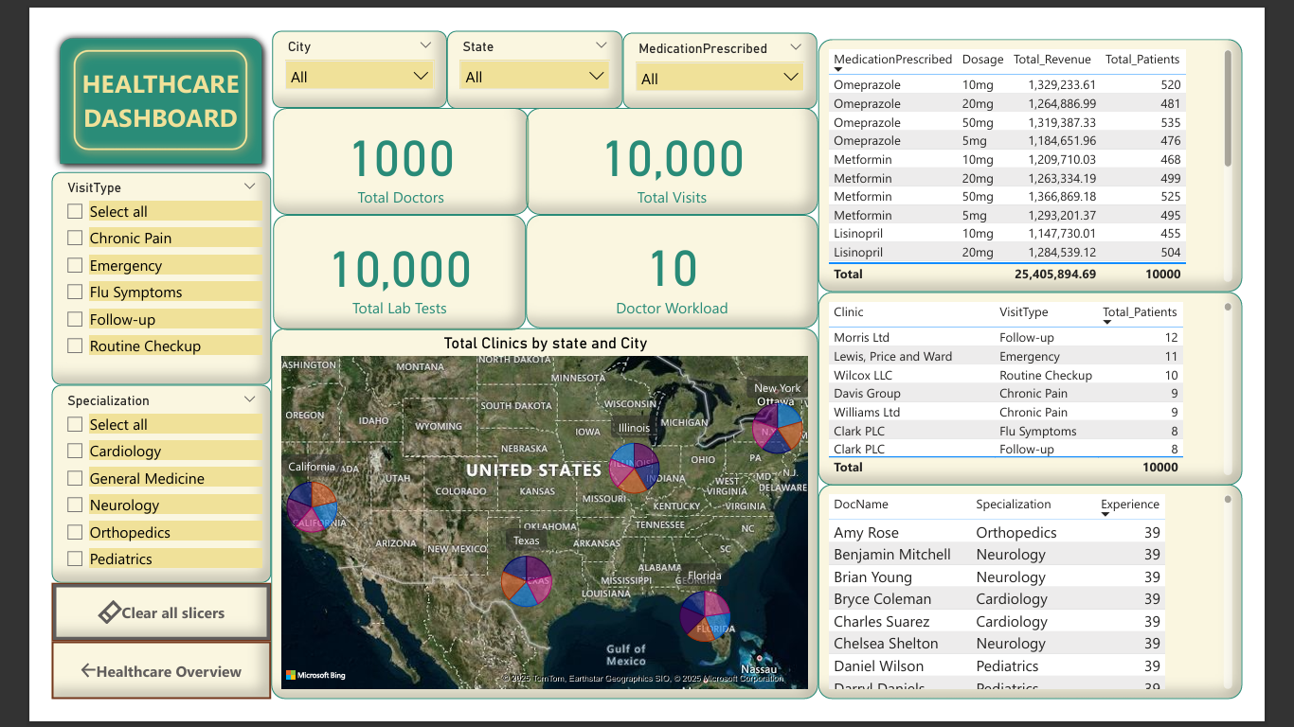
6. Power Bi Dashboard Page 2:

Slide 9














7. SQL Query Images 1:

Slide 10

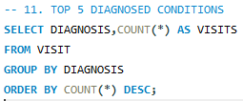


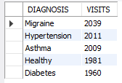



7. SQL Query Images 2:

Slide 11
8. Key Takeaways:
1. Operational Insights:
High Doctor Workload:
Avg. 10 patients/doctor (manageable but risks burnout).
Texas & California have the highest patient volumes - Consider resource redistribution.
Seasonal Trends:
Peak months (Jul–Oct) - Staffing/resources should scale up.
Lowest visits in Jan/Feb/Apr - Optimize scheduling during periods.
2. Clinical & Financial Performance
Revenue Drivers:
CT Scans/X-Rays generate the highest revenue - Prioritize imaging department efficiency.
31–60 age group contributes most revenue - Target preventive care for this demographic.
Treatment Costs:
Avg. $2,540/visit - Benchmark against industry standards for cost control.
33.01% success rate - Investigate low outcomes (e.g., adherence, misdiagnosis).
3. Patient Care Gaps
Follow-Up Rate (49.84%):
Half of patients skip follow-ups - Implement automated reminders or incentives.
Abnormal Lab Results (33.54%):
1 in 3 tests shows abnormalities - Focus on retest protocols and early interventions.
4. Diagnostic & Prescription Trends
Top Conditions: Migraine, Hypertension, Asthma, Diabetes → Expand chronic disease management programs.
Medications: Amoxicillin (most prescribed) - Audit antibiotic overuse to prevent resistance.
Low Lisinopril prescriptions - Potential under-treatment of hypertension.
5. Growth & Benchmarking
YoY Growth:
Patients doubled (5.1K → 10K); Revenue +92% ($13.19M → $25.41M) - Validate scalability of operations.

Slide 12
Challenges & Recommendations
Challenge | Recommendation
Low follow-up rate | Introduce SMS/email reminders + loyalty rewards.
High abnormal lab results | Flag repeat tests for accuracy; train lab staff.
Treatment success rate (33%) | Audit diagnosis protocols and patient education.
Seasonal demand spikes | Flexible staffing during peak months.

Slide 13
Thank You

